Slide 1
Chapter 9 Smart cities. Fog computing. IoT threats. Attack models. Assignment 2
Prof. E.B.Fernandez

Slide 2
Internet of Things (IoT)
Tagged objects that communicate through the Internet
Users can query their status and even control them
Physical objects can be part of applications or have their own standalone functions
Examples: devices in smart homes and wireless patient care, transportation systems using tags and devices, baby monitors, smart washing machines and refrigerators, webcams,…
A good amount of them are CPSs or part of CPSs

Slide 3
Internet of Things II
The IoT has found its application in various domains.
Examples include smart traffic control, smart grid, wireless sensor networks, precision agriculture, intelligent buildings, health care, industrial automation, oil and gas, etc.
The IoT has brought about an explosive proliferation of endpoints.
According to an estimate, nearly 50 billion heterogeneous devices will be connected to the internet by 2020.
Storage and processing costs are declining and the devices are getting smaller and less expensive.
Increasing intelligence of these devices
Huge amounts of data, most of it real time
90% of the world’s data was created in the last 2 years, and it is increasing exponentially.
We need to manage the large number of devices and process the data produced by them.
New threats [Bab10, Sin16]
<number>
Notes:
Cloud computing has established itself as a promising computing paradigm. However, the recent p
<number>

Slide 4
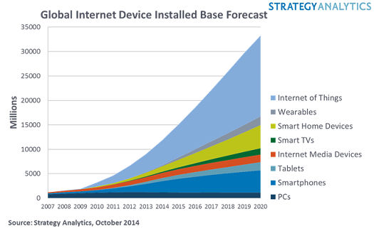

Slide 5
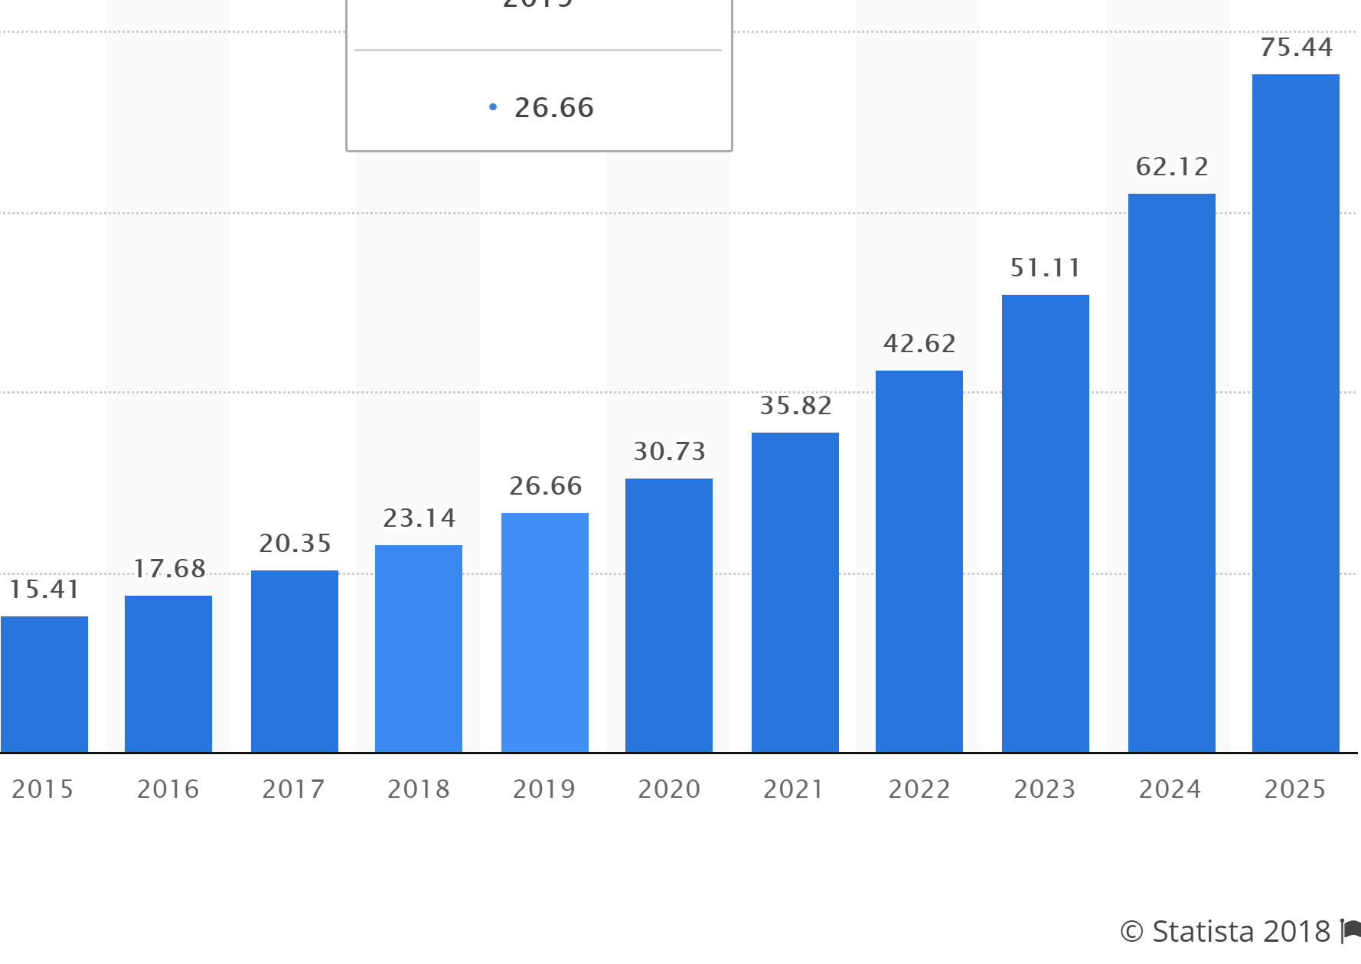
Installed base of connected devices (Billions)

Slide 6
Example of use: City transportation systems
Tags in vehicles, tags in fixed positions, tag readers,…
Can track location of vehicles, perform real-time traffic analysis, determine optimal routes,…
Use hybrid networks, combining Wi-Fi, GSM, GPS, IP, …
Used in bus systems, taxis,…

Slide 7
Possible layered architecture
Application layer: road guidance, shortest route,..
Intelligent service layer: vehicle management, data mining,..
Information awareness layer: associate and merge data
Resource management layer: collect real-time information from sensors, map matching,…
A Reference Architecture is needed

Slide 8
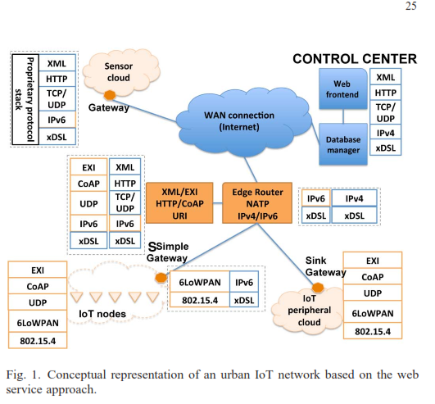

Slide 9
Smart cities
A smart city is a municipality that uses information and communication technologies to increase operational efficiency, share information with the public and improve both the quality of government services and citizen welfare.
A smart city is an urban area that uses different types of electronic data collection sensors to supply information which is used to manage assets and resources efficiently. This includes data collected from citizens, devices, and assets that is processed and analyzed to monitor and manage traffic and transportation systems, power plants, water supply networks, waste management, law enforcement, information systems, schools, libraries, hospitals, and other community services.
The smart city concept integrates information and communication technology (ICT), and various physical devices connected to the network (the Internet of things or IoT) to optimize the efficiency of city operations and services and connect to citizens.
Smart city technology allows city officials to interact directly with both community and city infrastructure and to monitor what is happening in the city and how the city is evolving.

Slide 10
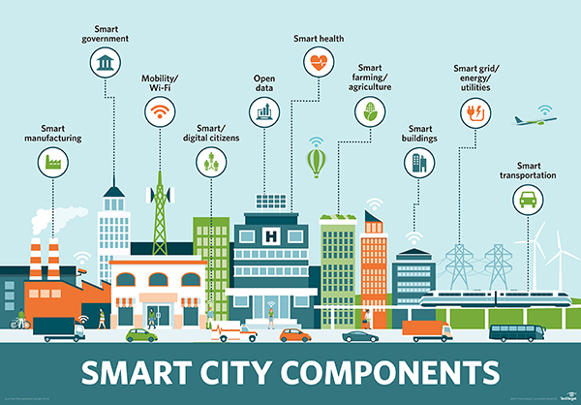

Slide 11
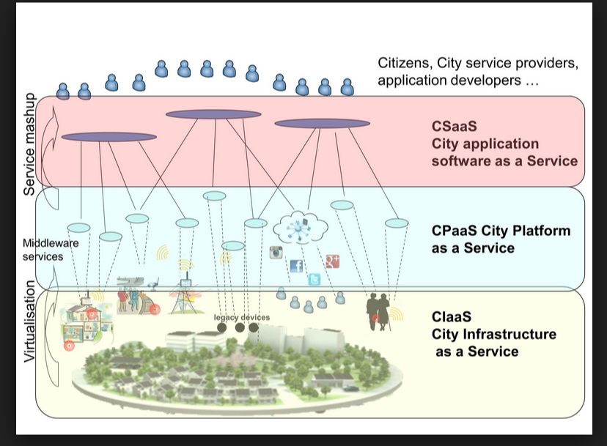

Slide 12
Current and coming smart cities
Union Point in Weymouth, MA (30 mins. from Boston)
https://www.nytimes.com/2018/04/03/business/smart-city.html
From October 2016, the government of the city of Hangzhou – home to over 9 million people – collaborated with Alibaba and Foxconn to build the “City Brain” project. The metropolis would be, from that moment forth, at least partly run by an AI that absorbed every last drop of data it could get its virtual hands on.
Every single resident was tracked; their activity on social networks, their purchases, their movements, their commutes – everything was uploaded to the AI’s database, which then made real-time decisions.
Over time, it was allowed to develop a neural network across the city. Everything from the water supply to the sizes of crowds in certain areas was taken into account.

Slide 13
Issues
Large amounts of heterogeneous information: RFID, addresses, GPS data,…
Noisy data: must be cleaned
Need for unified data model
Data processing: probabilistic queries
Need for automatic event detection
Efficient and flexible heterogeneous wireless networks are needed

Slide 14
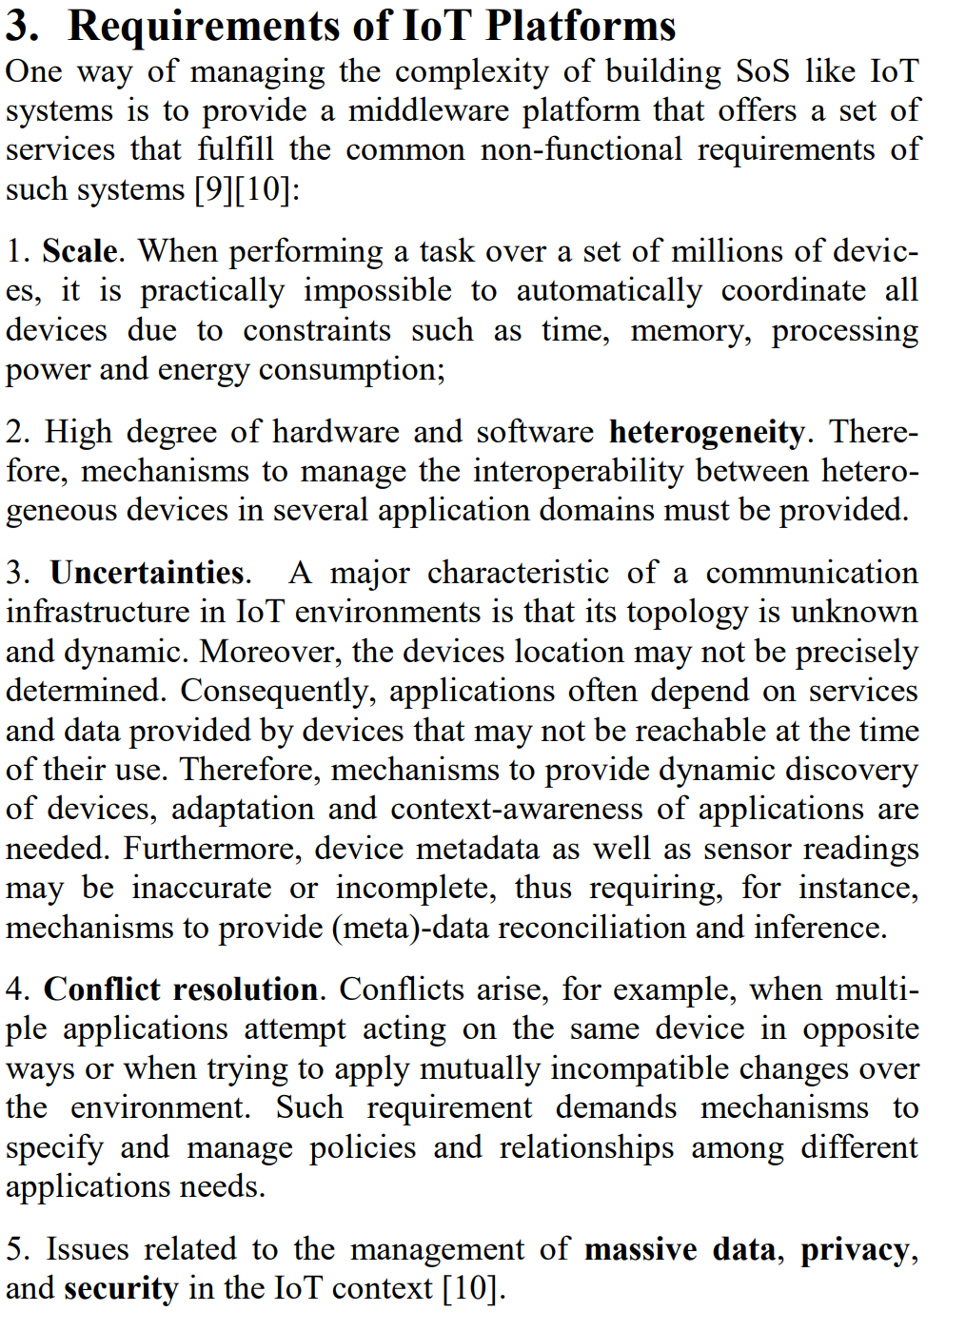

Slide 15
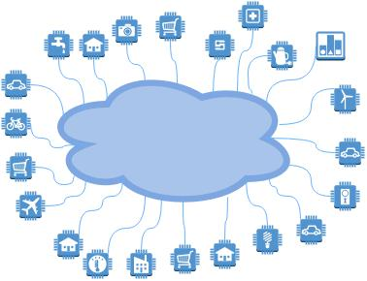
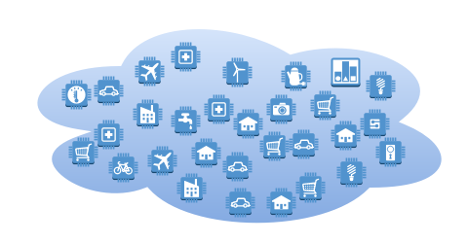
Internet of Things with Clouds

Slide 16
Problem Domain
Cloud Ecosystems
Security Issues in Fog Computing
Fog Computing
Security and Privacy
Internet of Things

Slide 17
Internet of Things and Fog Computing
IoT applications require low latency, mobility support, location awareness and support for geo-distribution.
Popularity of IoT has made the limitations of clouds more apparent, We need new solutions.
Fog computing offers one of such solutions.
It complements rather than replaces the cloud.
Cisco fog computing solutions, Amazon Web Services (AWS) Amazon IoT cloud service, IBM IoT solutions for analytics.
Numerous papers discuss these IoT applications in connection to fog computing. Ours was the first pattern for fog computing.
Containers are also providing more lightweight, portable virtualization solutions that will offer support for IoT applications.
<number>
Notes:
Cloud computing has established itself as a promising computing paradigm. However, the recent p
<number>

Slide 18
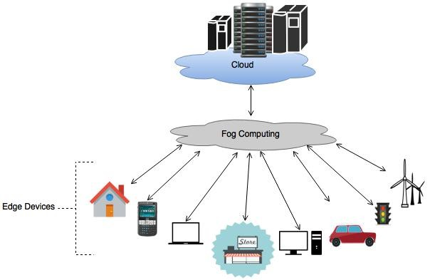
Fog Computing
Intent Fog Computing is a virtualized platform that stands between cloud computing systems and Internet devices, providing to these computation, storage, and networking services and allowing a cloud to control and communicate with these devices.
Fog can offer low latency, location awareness, efficient use of bandwidth and storage services.
Cisco provides fog computing platforms
Figure 3: Idea of Fog Computing
Notes:
<number>

Slide 19
Solution
Introduce a platform to provide cloud computing-like services closer to the devices to be monitored or controlled. This is called Fog Computing.
It provides computation, storage, and networking services between end user devices and cloud providers. Data is processed locally for better response. Aggregated data and other relevant information can be forwarded to the cloud for analysis.
The Fog is a collection of several distributed tiny clouds called Fog Nodes. They can be resource-rich servers, routers, access points, mobile devices etc. A Fog Node has resources including hardware (compute, networking and storage) capabilities.
These nodes provide local real-time data analytics capabilities using an Analytics Engine.
Applications can be hosted in the fog nodes using virtualization, Virtual Machine (VM) and/or Containers.
A database stores both application data and necessary metadata for service orchestration.
It also has information about hardware and software capabilities of nodes, information about the state of fog nodes and services, policies for security, filtering, and configuration.
Fog computing uses a Reference monitor to perform policy-based service orchestration.
A Policy Manager is triggered by service requests and a Decision Maker Engine (Reference Monitor) gathers relevant policies and metadata to decide about requests.
Reference monitor enforces the authorization rules and authenticator is used for providing access control. In addition, services like filtering, aggregation of data, logging, etc., can be provided.
<number>
Notes:
<number>

Slide 20
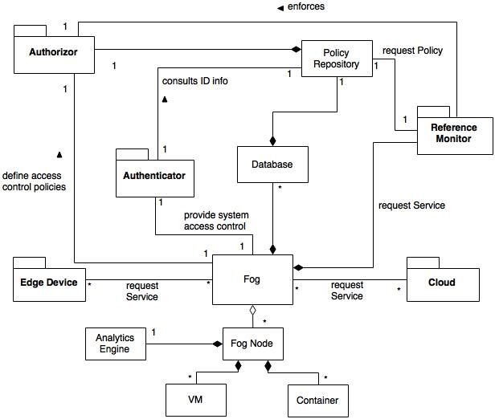
Class diagram of the Fog Computing pattern
Notes:
<number>

Slide 21
Implementation
Fog computing requires multi-tenancy support for applications, from different software companies or developers, that need to execute without interfering with each other. So, the cloud platform in devices comprising the fog platform should support multi-tenancy for applications.
Despite multi-tenancy fog devices should be able to execute applications in isolation to prevent unwanted interference from other processes.
Policies have to be defined to control service orchestration, filtering and for adding security.
Decentralized management mechanisms need to be established to setup and configure a large number of devices in fog [Vaquero and Merino 2014].
Bonomi et al. [2014] mentions a local software agent on each fog node, called foglet, which monitors the state of the node and services. Foglets also perform lifecycle activities and orchestration. Also they mention fog abstraction layer which provides uniform programmable interface for resource control and management. It provides generic APIs to monitor and manage heterogeneous fog devices.

Slide 22
IoT ecosystems: Big IoT project in EU (http://big-iot.eu/project/)
Objective 1: Define a shared interface with services such as discovery, access, and management of events
Objective 2: Establish a centralized marketplace where platformas and services can be registered

Slide 23
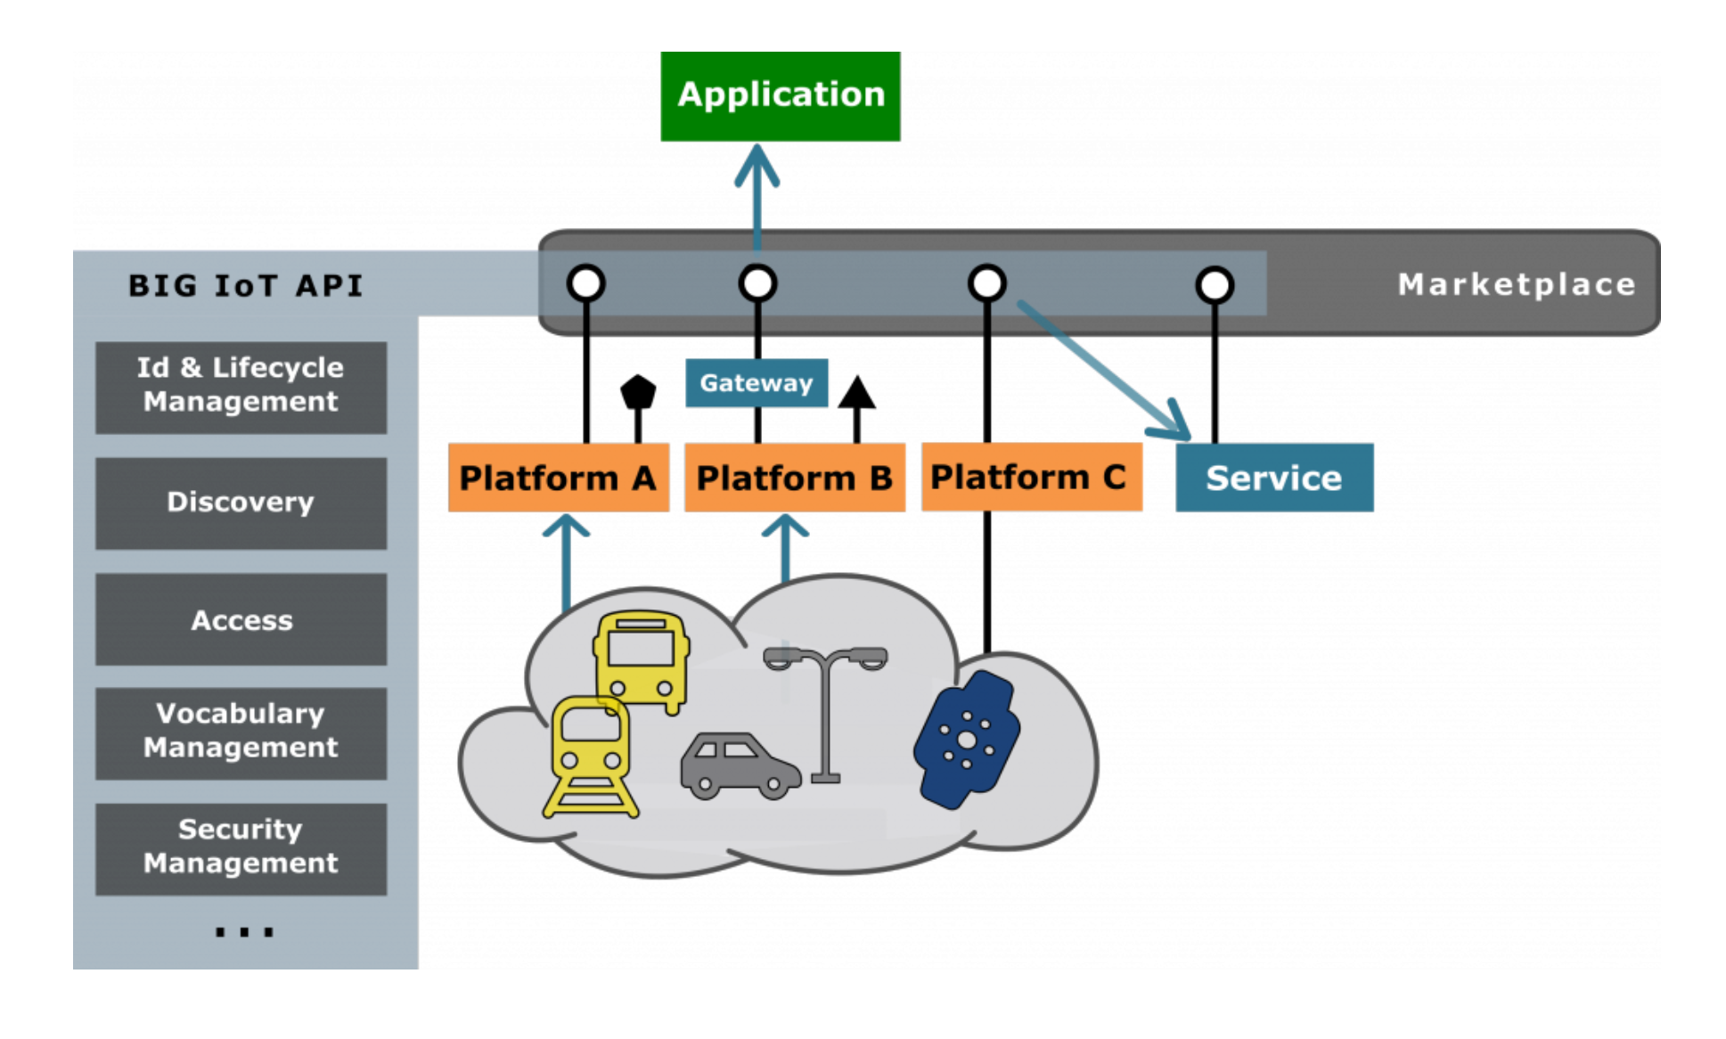
Big IoT project EU

Slide 24
Big IoT security objectives
End to end security—enforced in API
Adaptable security architecture—new atatcks and defenses, new yechnologies and topologies
Flexible authentication and authorization—decentralized, federated, delegated
Asset transfers—assets and components can be sold or transferred
Accountability and billing—secure billing for resources
Continuous security—ready to handle compromised nodes, hostile participants, and other security threats
Secure development—use of secure software development methodologies and secure coding

Slide 25
IoT mashups [Del13]
Applications developed in an opportunistic and ad hoc fashion by potentially non-experts, on top of smart things, by using the mashup approach.
Such applications rely on a sunset of a collection of web-accessible servicesnad data made available by object intermittently connected to the network
Examples: sensors monitor temperature in locations can be combined with maps to show their location
Their interaction model needs to be looser that in traditional web services compositions because of the unpredictability of the services
Use XML as mashup language

Slide 26
An agile methodology for secure IoT systems
Agile methods emphasize continuous delivery of code and do not use models
A few secure agile methodologies have appeared
Can we adapt them to build secure IoT systems?

Slide 27
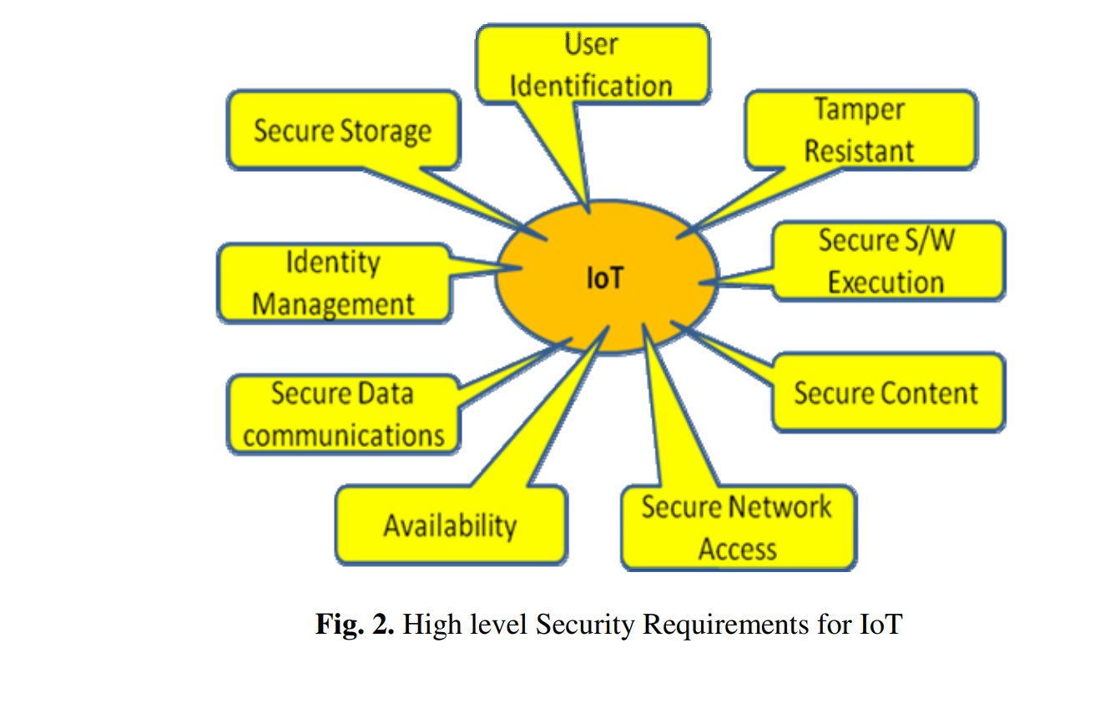
[Bab10]

Slide 28
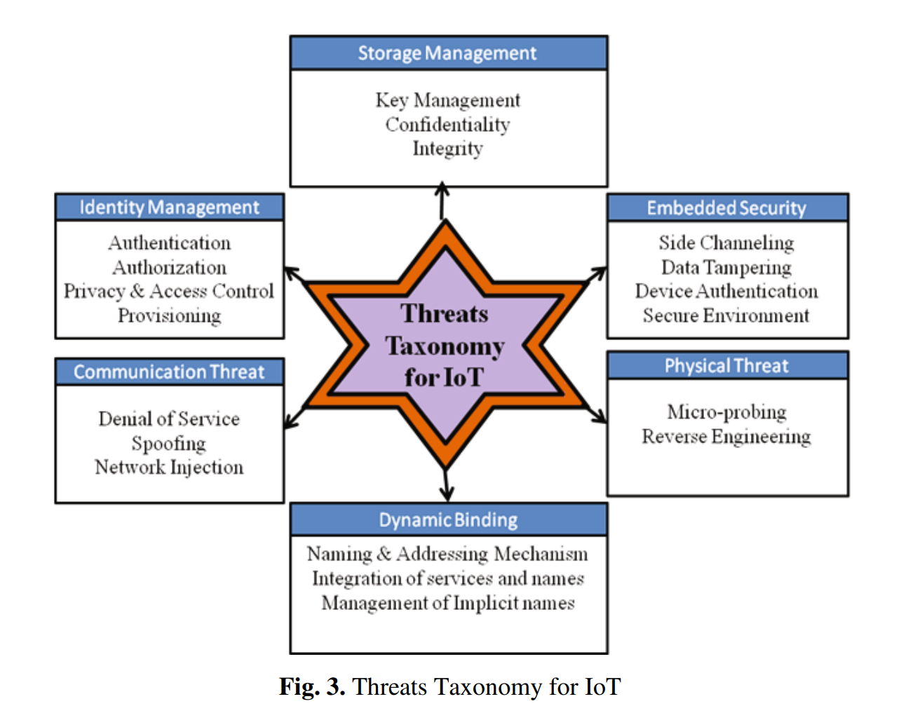
[Bab10]

Slide 29
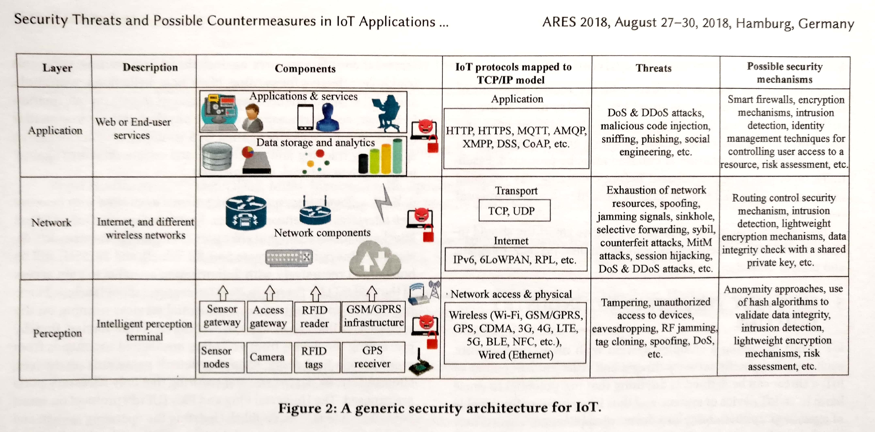
[Sam18]

Slide 30
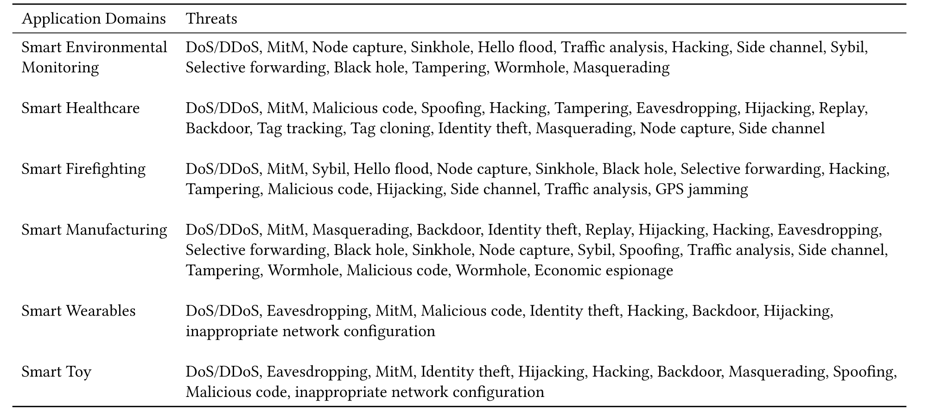
[Sam18]

Slide 31
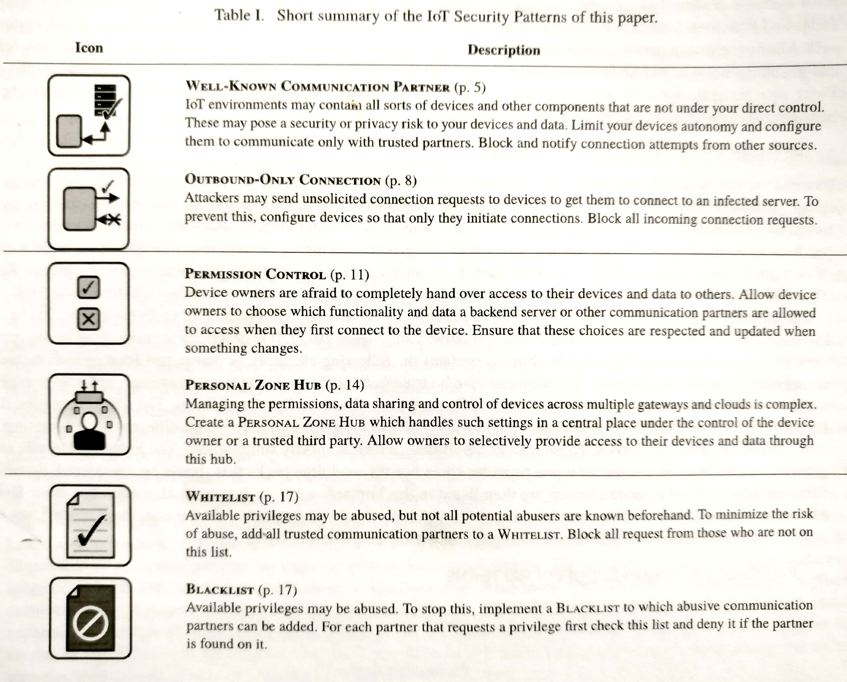
[Rei17]

Slide 32
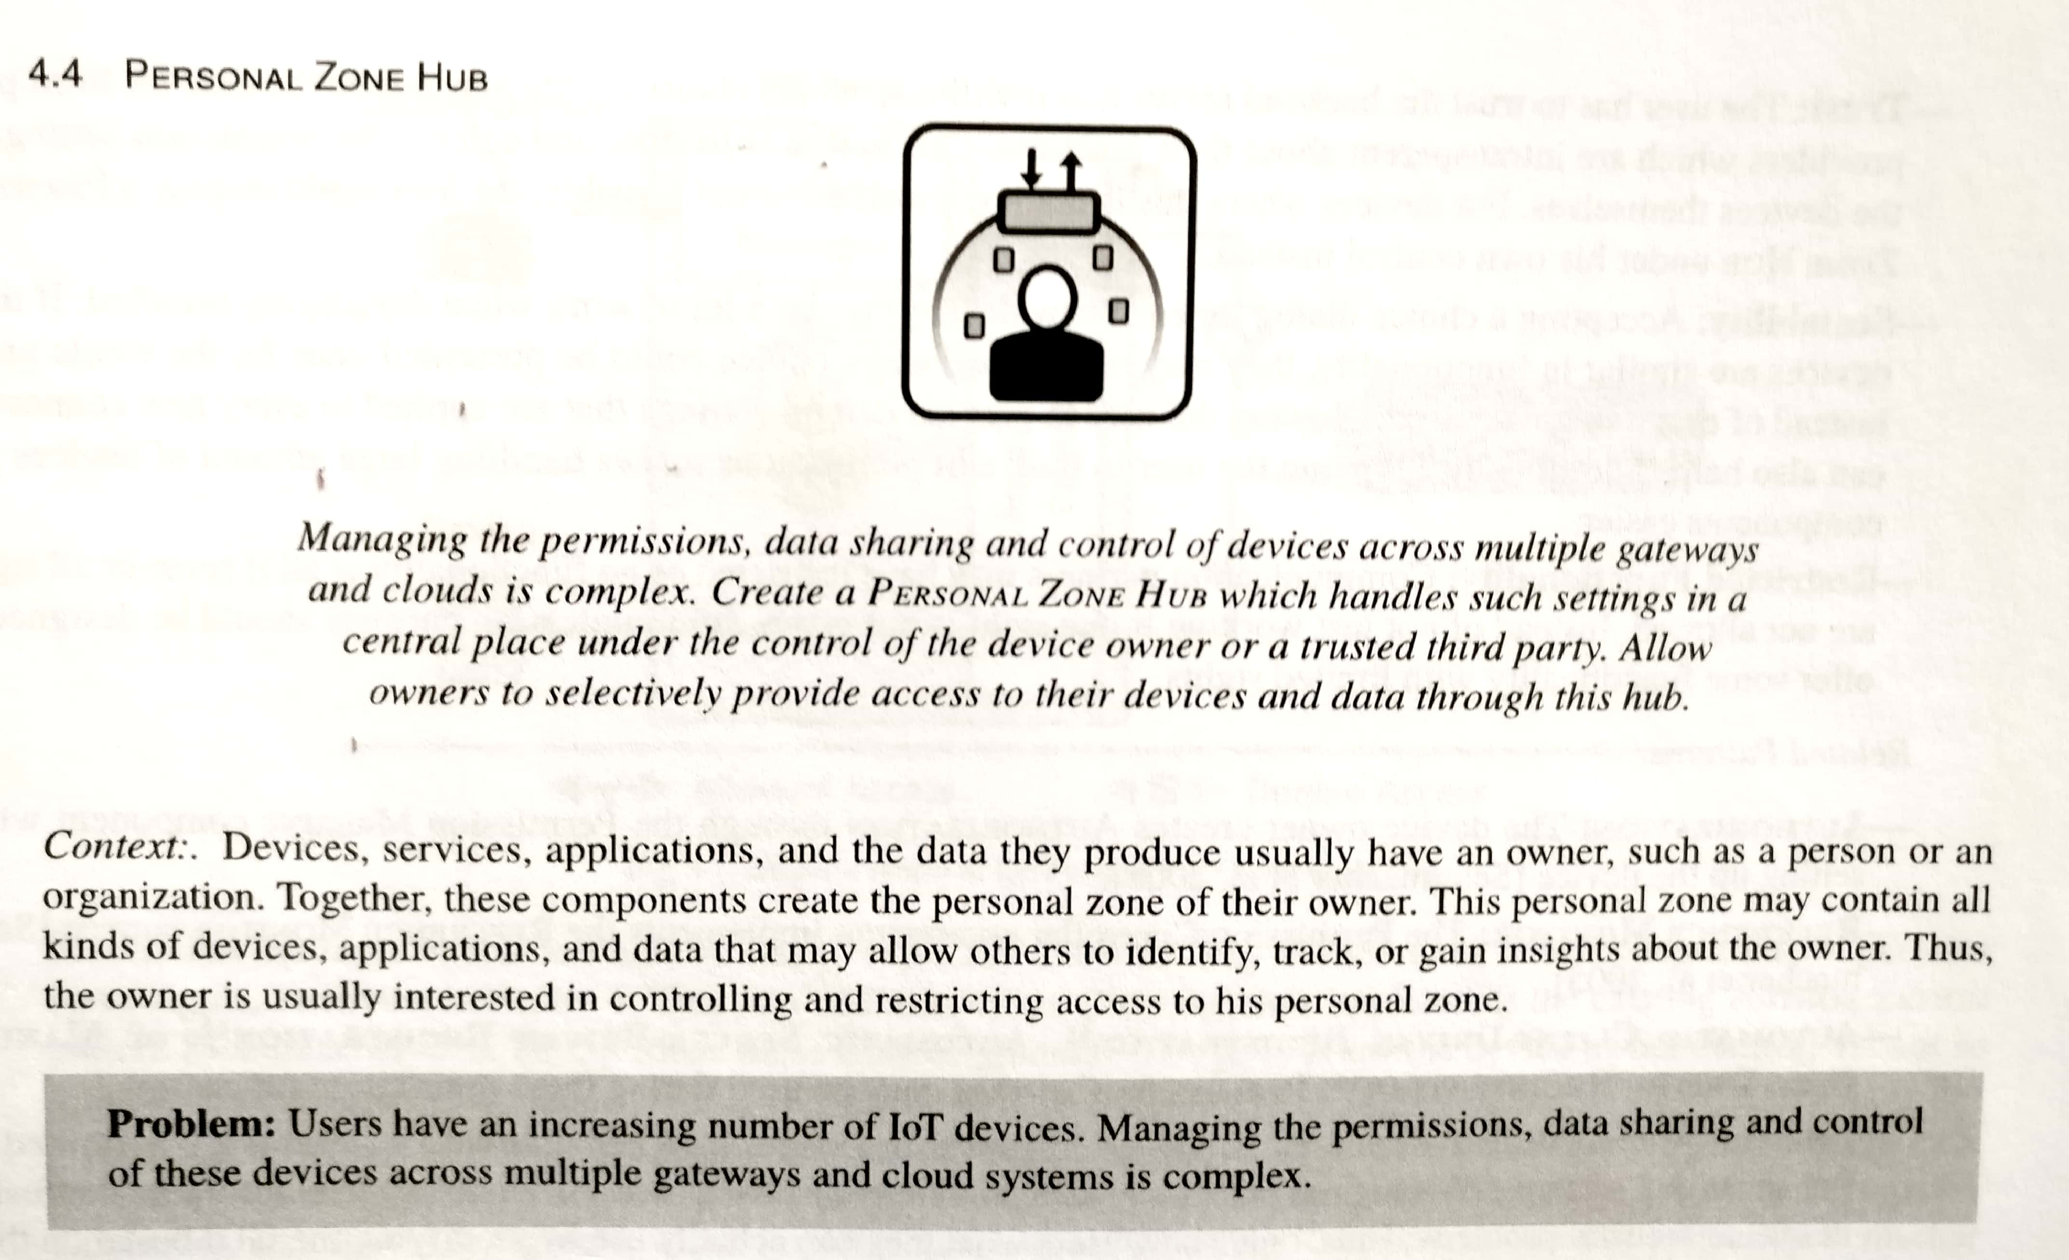

Slide 33
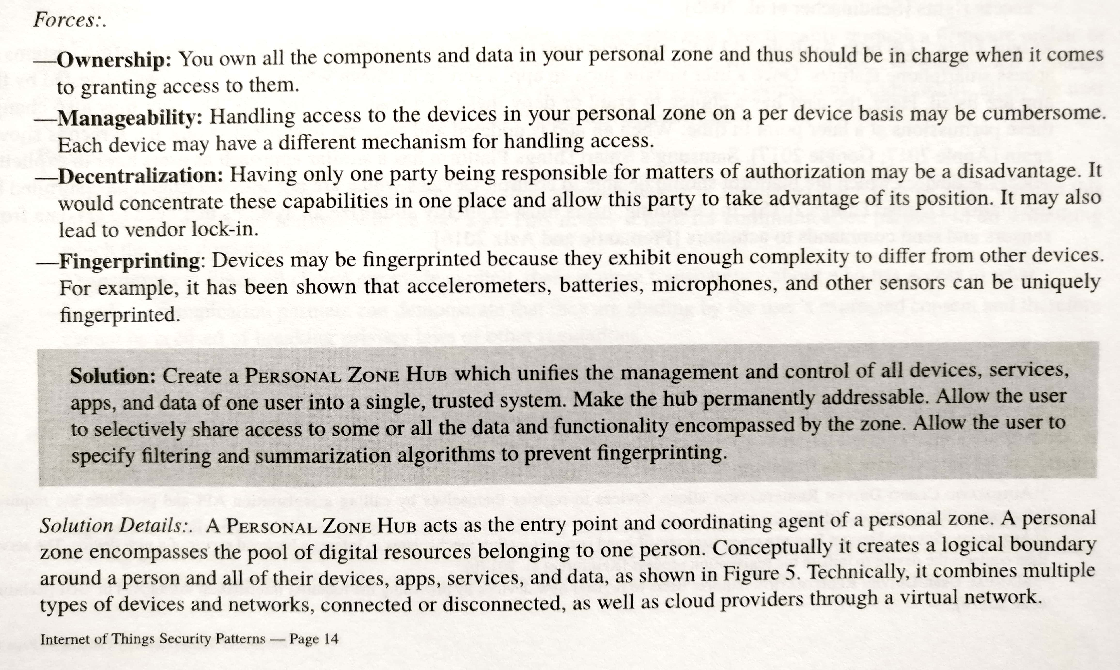

Slide 34
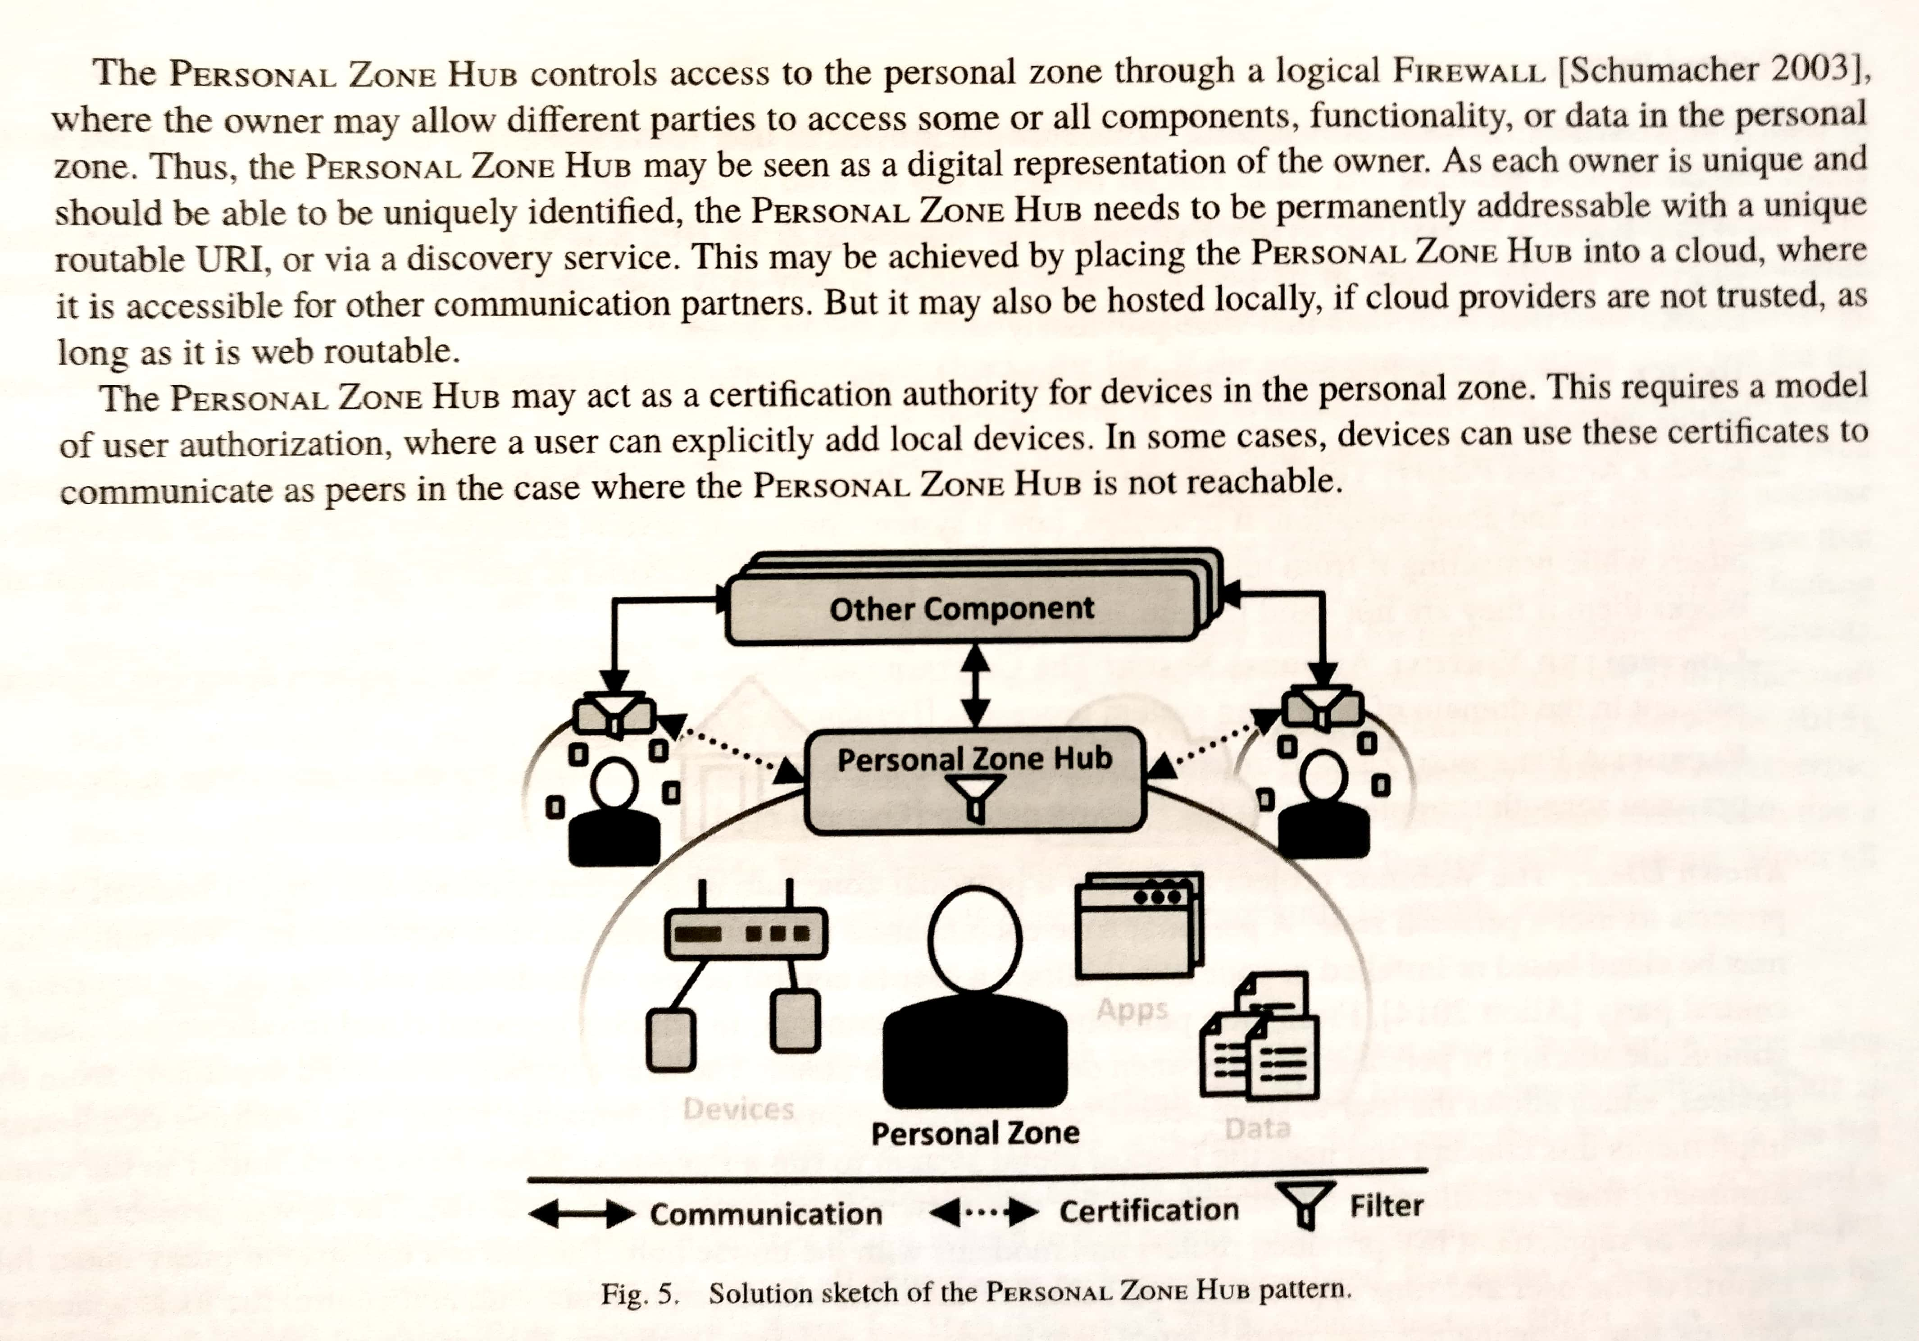

Slide 35
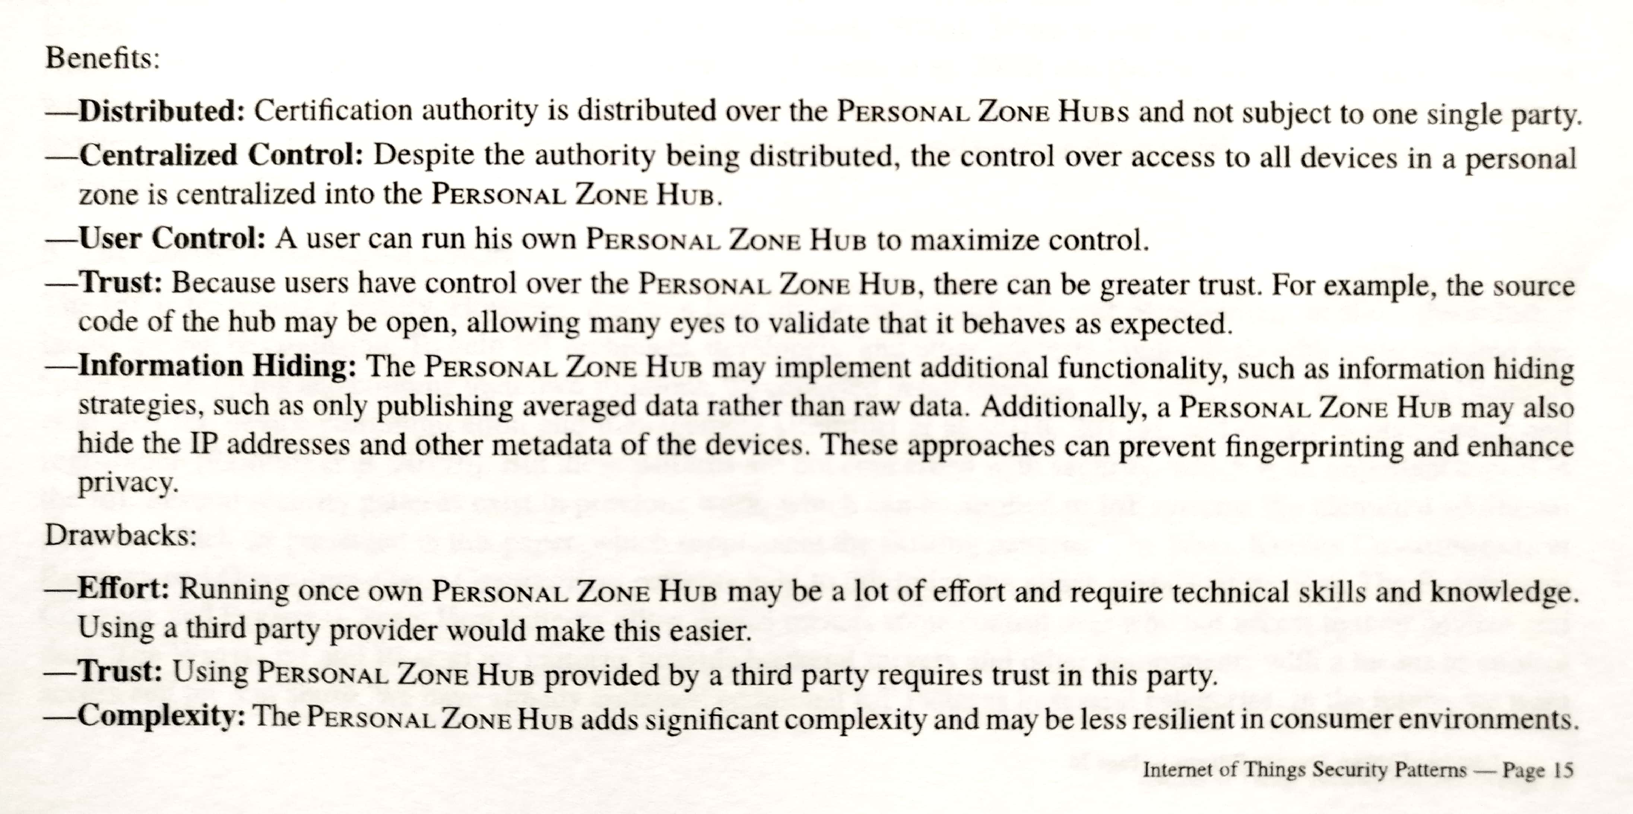

Slide 37
An IoT misuse pattern: DDoS attack on the IoT [Sye18]
Intent
An attacker intends to make a target unavailable by flooding its resources (a DDoS attack) with a large volume of traffic produced by IoT devices.
Context
There are a large number of smart and heterogenous devices connected to the internet. These devices have limited computational capabilities, are diverse, pervasive and very large in number. In addition, IoT devices are also categorized as producers of large volumes of data in a very short time and can have weak or default security configurations.

Slide 38
Vulnerabilities
The urgency to adopt IoT solutions has left the systems with many vulnerabilities which can be exploited to perform attacks.
IoT devices offer weak security defenses. IoT technology is still very young and it will take more time for it to become mature through trial and testing. Secondly, more focus has been on usability as compared to security of the systems. Manufacturers and consumers of the IoT devices do not have a vested interest in security of devices. The devices prioritize functionality and usability over security.
There are many devices of the same type. Once a vulnerability is known, it can be used on many devices.
IoT devices have limited computational abilities making it difficult to provide computationally expensive security measures. For example, performing intrusion detection might be beyond their capabilities.

Slide 39
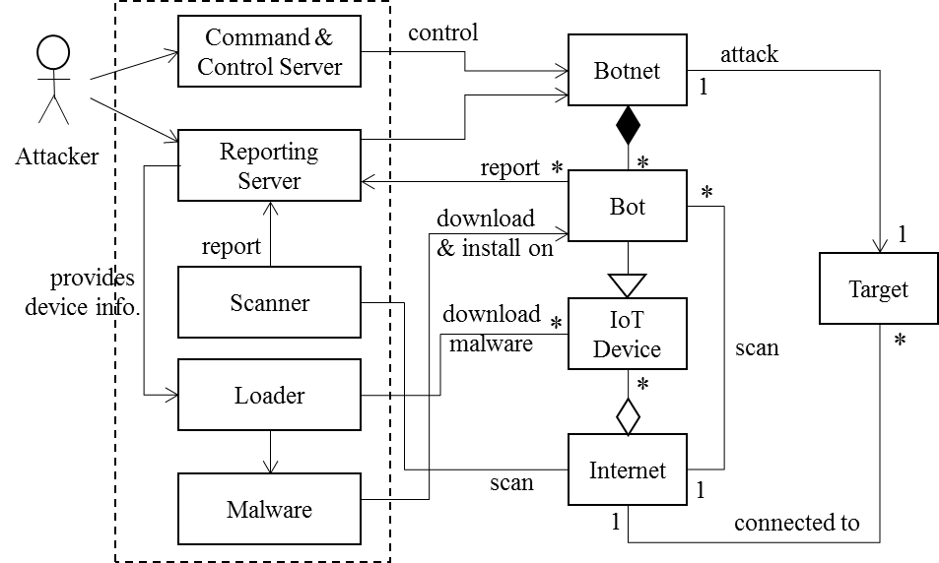
IoT Bot class diagram

Slide 40
Structure
Structure
The previous figure shows the environment in which a DDoS attack takes place.
IoT Devices and Target are both connected to the internet. Attacker uses the tools shown in the dotted section of the diagram.
A Command and Control (CC) Server provides a centralized management platform for orchestrating the attack.
Scanner scans the internet for IoT devices that can be useful in the attack. The vulnerable IoT devices are attacked to discover security credentials using brute force attacks.
Reporting server stores the information about bots. Loader logs into an IoT device and instructs it download and install Malware, turning it into a Bot (a compromised device).
Botnet is the network of bots which is used to launch an attack upon receiving the signal from the CC server.

Slide 41
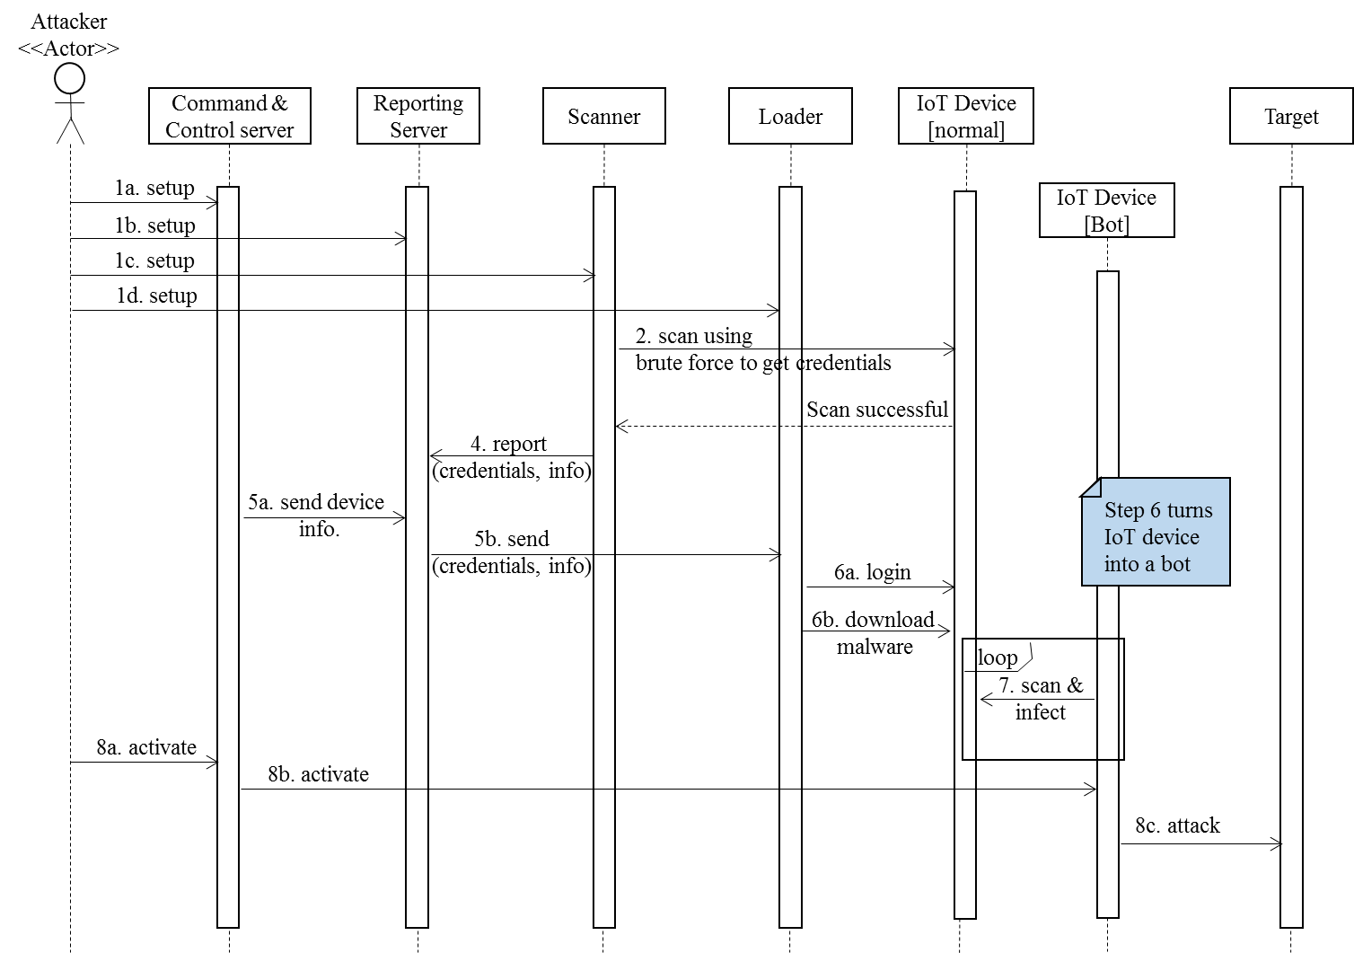
DDoS using botnets

Slide 42
Use case: DDoS attack and misuse
Attacker sets up command control server, reporting server, loader and scanner.
Scanner searches the internet for vulnerable IoT device and brute force search is used to find security credentials of discovered IoT devices.
Scanner reports compromised device information to the reporting server including the credentials, IP addresses, security configurations, etc. This information is stored on the reporting server.
Command and Control Server sends the information from reporting server to the loader.
Loader logs on the vulnerable IoT device and instructs it to download and execute malware, converting them into bots.
Bots scan for other IoT devices to make them part of the Botnet as well as await the attack command from the Command and Control server.
Command and Control server sends attack command to Botnet and all bots direct traffic to target.
Target receives huge volume of traffic from the Botnet which uses up its bandwidth and resources, disrupting its operations.

Slide 43
Known uses
Krebs on Security website was targeted with a DDoS attack with traffic up to 665 Gigabits of traffic per second (Krebs 2016).
French webhost and cloud service provider OVH was hit with a 1.1 Tbps DDoS using Mirai bots which was used to hack more than 145k cameras (Goodin 2016). Mirai bot used dictionary attack with only 62 combinations to break the security credentials of IoT devices (Kolias et al. 2017).
Domain Name Service provider Dyn was attacked with a 1.2 Tpbs DDoS using unsecured IoT devices (Schneier 2016).
IoTroop botnet targeted a financial service company with DDoS (Townsend 2018).

Slide 44
Attack models for IT and IoT
Lockheed Martin proposed Cyber Kill Chain (CKC)
After that, derived models are Mitre’s ATT&CK, Bryant, and Mandiant
Models for CPS (ICS) attack include SANS ICS CKC
Another model was just proposed, SAMIIT [Has18].

Slide 45
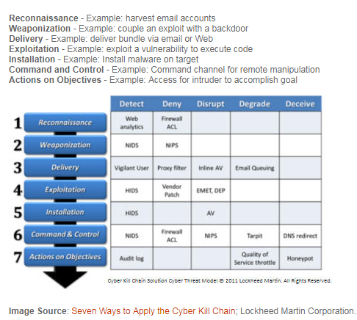

Slide 46
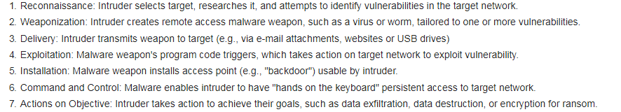
Steps of CKC

Slide 47
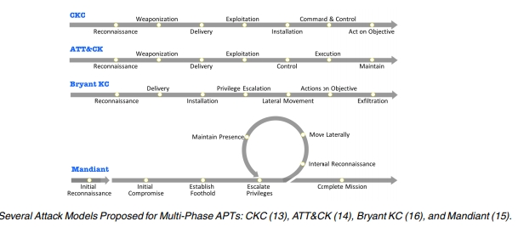
[Has18]

Slide 48
IIoT zoned architecture and CKC for ICSs
Fig. 2 shows an architecture for ICSs, where there are multiple zones.
A zone is a set of network and operational entities grouped together to form a set of services and applications.
Although any asset can be a target, usually the final target is a host/device in the control zone (levels 0-2).
The main attack gains entry through IT systems and traverses the OT infrastructure by launching multiple attacks, that require a recurring set of phases.
This means that an attack model must take into account the architectural levels (zones).

Slide 49
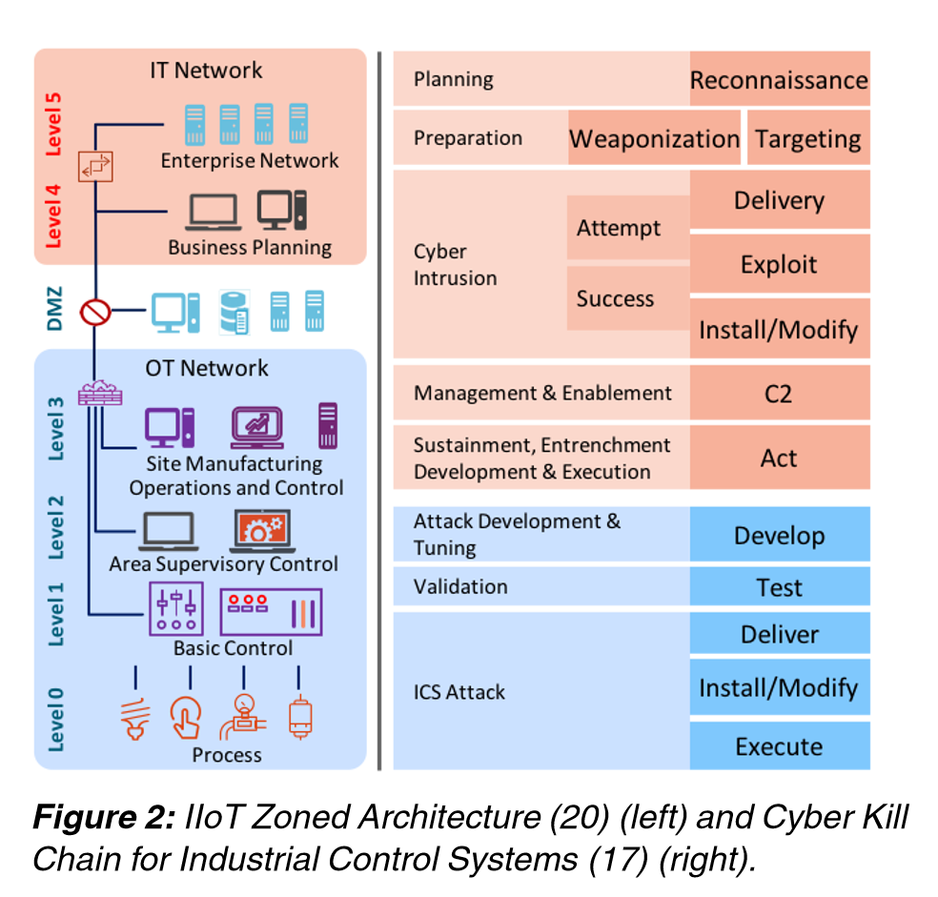

Slide 50
New model SAMIIT
Colors correspond to zones in architecture
Shows typical times to complete each phase
Pre-compromise part is the same as in CKC
The IT zone is the usual target of the pre-compromise parts
When the malware is installed and externally controlled the attacker has established a foothold
The attacker now searches for vulnerable systems, escalates privilege, and moves laterally (horizontally or vertically) towards the final target
The gray area can be extended to multiple cycles and becomes a spiral mode of attack

Slide 51
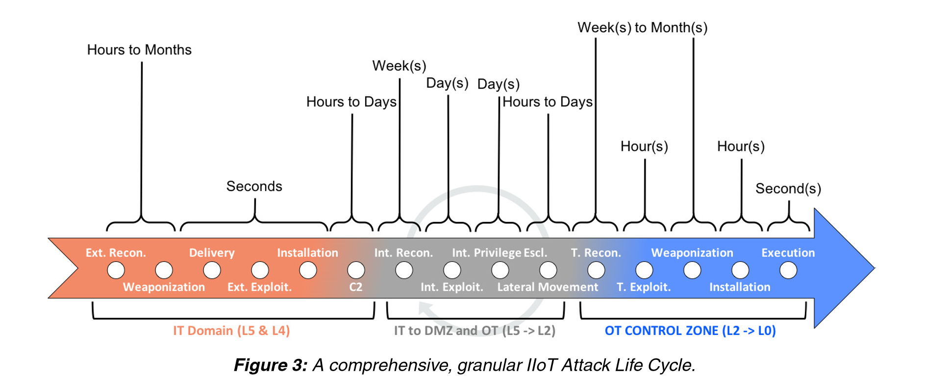
Spiral Attack Model in IIoT (SAMIIT)

Slide 52
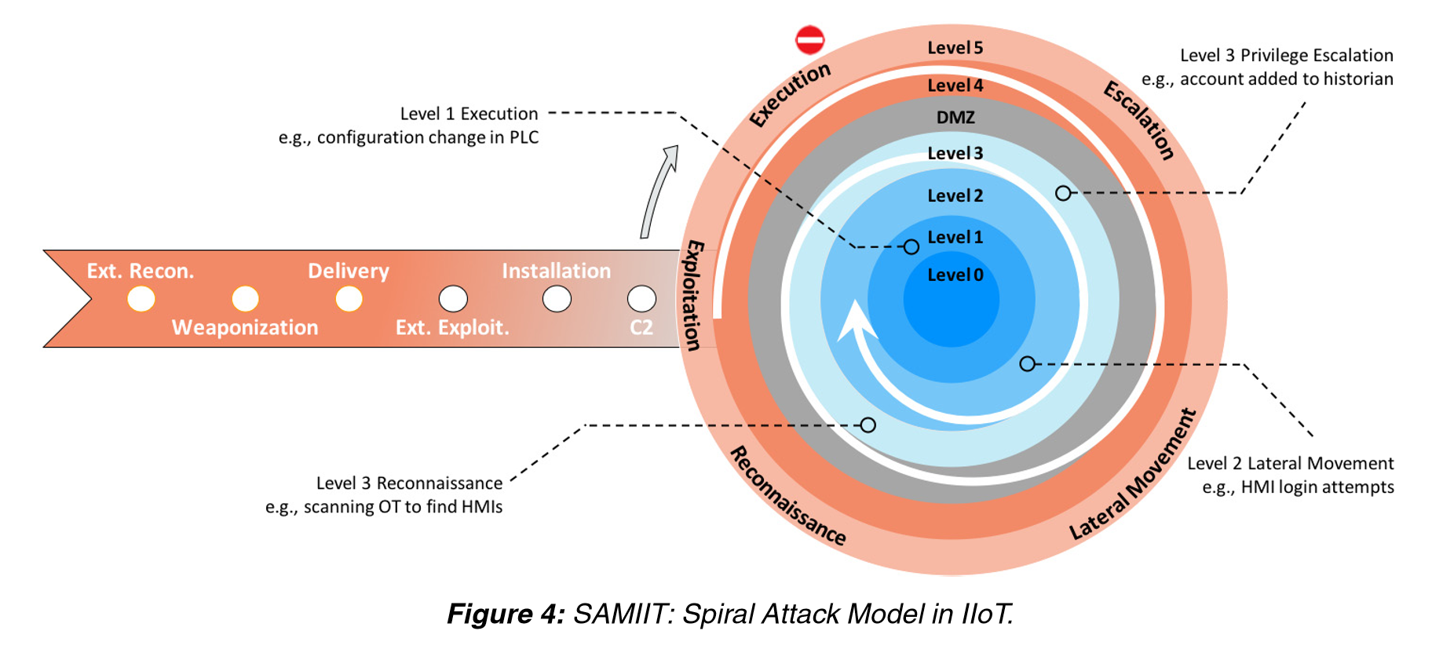

Slide 53
Assignment 2 (due Th Nov 15)
Q1. We would like to combine the Cyber Kill Chain (CKC) Model with our misuse patterns. Describe the idea and use as example the DDoS attack using Botnets or a similar attack.
Q2. Study OpenStack security. Find threats and countermeasures. Look in the Internet, make a structured and systematic list according to architectural effects.
As usual, write concisely and precisely, itemize your key ideas (no long, verbose paragraphs), give references.

Slide 54
References
[Has18] A. Hassanzadeh, R. Burkett, “SAMIIT: Spiral Attack Model in IIoT - Mapping Security Alerts to Attack Life Cycle Phases, Procs. ICS & SCADA 2018, 11-20
[Sye18] MH Syed and EB Fernandez, “A misuse Pattern for DDoS in the IoT”, EuroPLoP 2018
Madiha H. Syed, E.B.Fernandez, M.Ilyas, “A pattern for fog computing”, Pattern Languages of Programming (VikingPLoP 2016), 7th-10th April 2016, Leerdam, Netherlands
Madiha H. Syed and E.B.Fernandez, “Cloud ecosystems support for Internet of Things and DevOps using patterns”, First International Workshop on Interoperability, Integration, and Interconnection of Internet of Things Systems (I4T), part of the IEEE Int. Conf. on Cloud Engineering (IC2E), Berlin, Germany, April 4-8, 2016.

Slide 55
References II
[Del13] F.Delicato et al., “Towards an IoT ecosystem”, SESoS 2013
[Bab10] Sachin Babar, Parikshit Mahalle, Antonietta Stango, Neeli Prasad, and Ramjee Prasad, “Proposed Security Model and Threat Taxonomy for the Internet of Things (IoT)”, CNSA 2010, CCIS 89, pp. 420–429, 2010. ftp://ftp.inf.puc-rio.br/pub/docs/FomularioSolicitacoes/MarkusEndler-04-14.pdf
Loke, Seng W. "The Internet of Flying Things: Opportunities and Challenges with Airborne Fog , Computing and Mobile Cloud in the Clouds." IEEE (2015).
[Rei17] L. Reinfurt et al., “Internet of Things security patterns”, PLoP’17, Vancouver, CA, Oct. 2017
[Sam18] M.G.Samaila et al., “Security threats and possible countermeasures in IoT”, Procs. ARES 2018
[Sin16] Jatinder Singh, Thomas Pasquier, Jean Bacon, Hajoon Ko, and David Eyers, “Twenty security considerations for cloud-supported Internet of Things”, Internet of Things Journal, vol. 3, No 3, June 2016, 269-284. DOI: 10.1109/JIOT.2015.2460333
Jeffrey Voas, Networks of ‘Things’, NIST Special Publication 800-183, July 2016, http://dx.doi.org/10.6028/NIST

